Slide 1

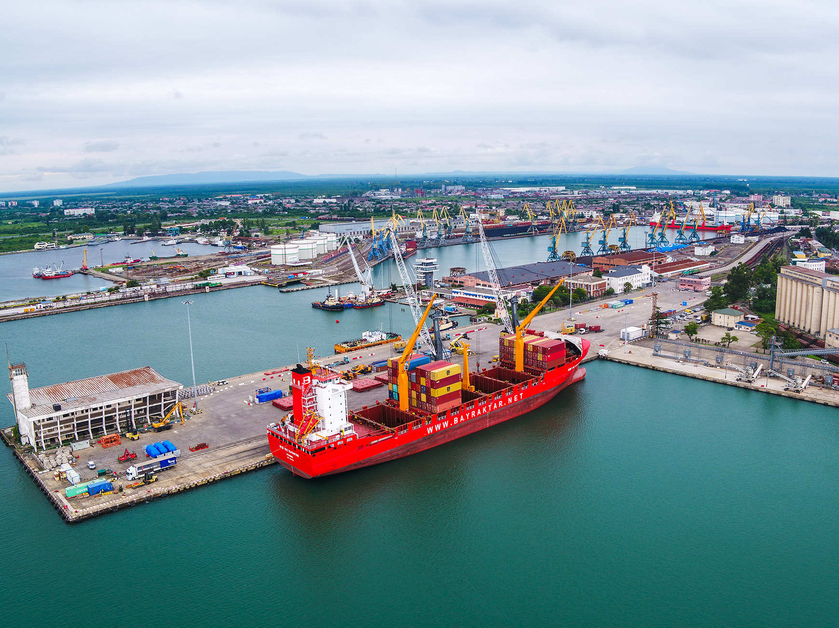
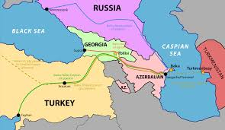





POTI PORT GEORGIA
WMS/3PL Georgia Summit 2024
Tbilisi Marriott hotel 25 June 2024

Slide 2
KP (Klein & Pantsulaia) & KI (Armenian branch called Klein & Iskandaryan) Organize Summits and Parties in Caucuses
2 Opening parties in Nov and Dec 2022 where we gave free weekends at the Mercure Old Town and Gift certificates for upstairs restaurant (we were in contact with Marian at Mercure….last year I was a Platinum member….now a Gold member of All Accor)
2 IT Georgia & Armenia Summits at the Tbilisi Marriot (Feb & May23)
1 IT Georgia & Armenia Summit at the Marriott Armenia (Jul 23)
1 IT/AI Georgia & Armenia Summit at the Tbilisi Marriott (21Sept23)

Slide 3


MEDIA
We have a banner ad that we will change to reflect the Summit
  The GT banner ad appears currently on every page for all articles (www.georgiatoday.ge) see page 4
  250K hits a month verified by an Independent IT professional (every 11 seconds)
  When the link is clicked it goes to a landing page on Events - Klein Law Group Georgia …page 6
We will run at least 3 Full Page ads in Georgia Today (circulation 5000) and an ad in the AmCham quarterly magazine that runs next month …page 6
  Usually our print versions of the paper appear in the hotel and when people sitting in the lobby they will perhaps see reference to the event and reference to the Hotel.
All logos including hotel logo, GT, GT Business, HOTEL RESTAURANT(s) and our main Sponsor Poti Logistic Park
AmCham Georgia and Armenia (we are members of both) send mass mailing about the event and sponsors etc 1 week before the event to their very large mailing lists
We heavily post on Linkedin with thousands of followers amongst the team. Between several of our partners we have over 7000 contacts of which over 1000 are in Georgia
Daniel Klein is the Legal Journalist for Georgia today Georgia Today Legal Column - Klein Law Group Georgia
We write reports of the events in Georgia Today KP in the News - Klein Law Group Georgia. The report will appear 3 days after the event on June 19, 2024
We email confirmations and follow up post events
We have 2 videographers who create a video

Slide 4


Sponsors so far
& Looking for Speakers
WMS/3PL Georgia Summit 2024
@ the Tbilisi Marriott 25 June

Slide 5
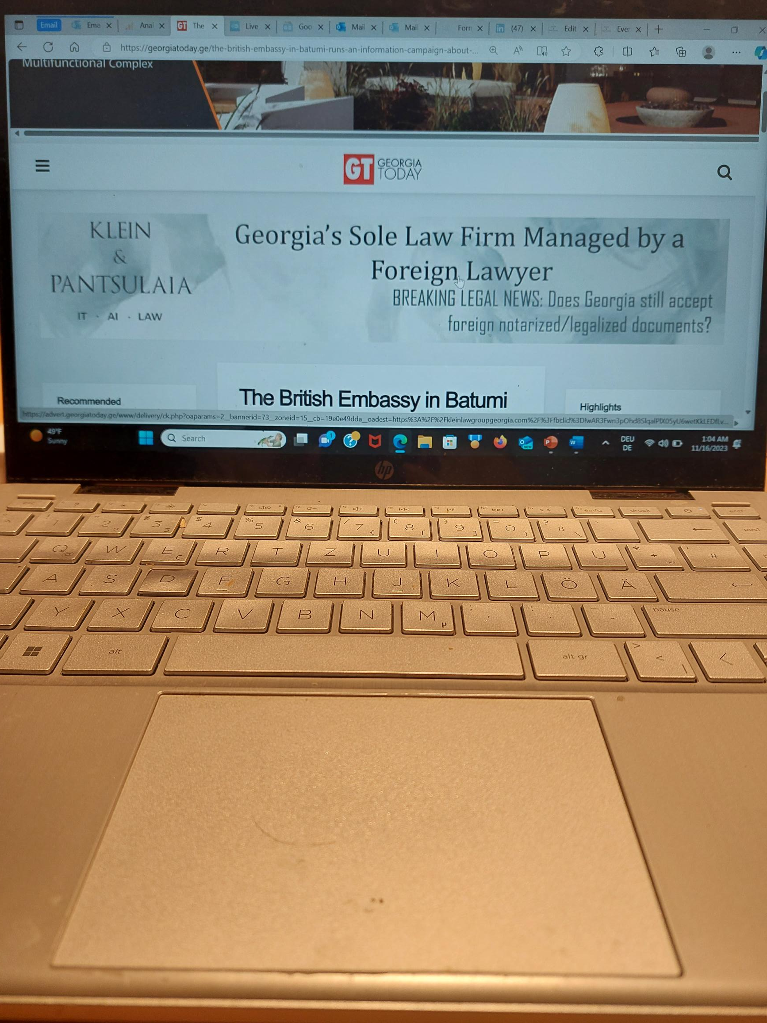
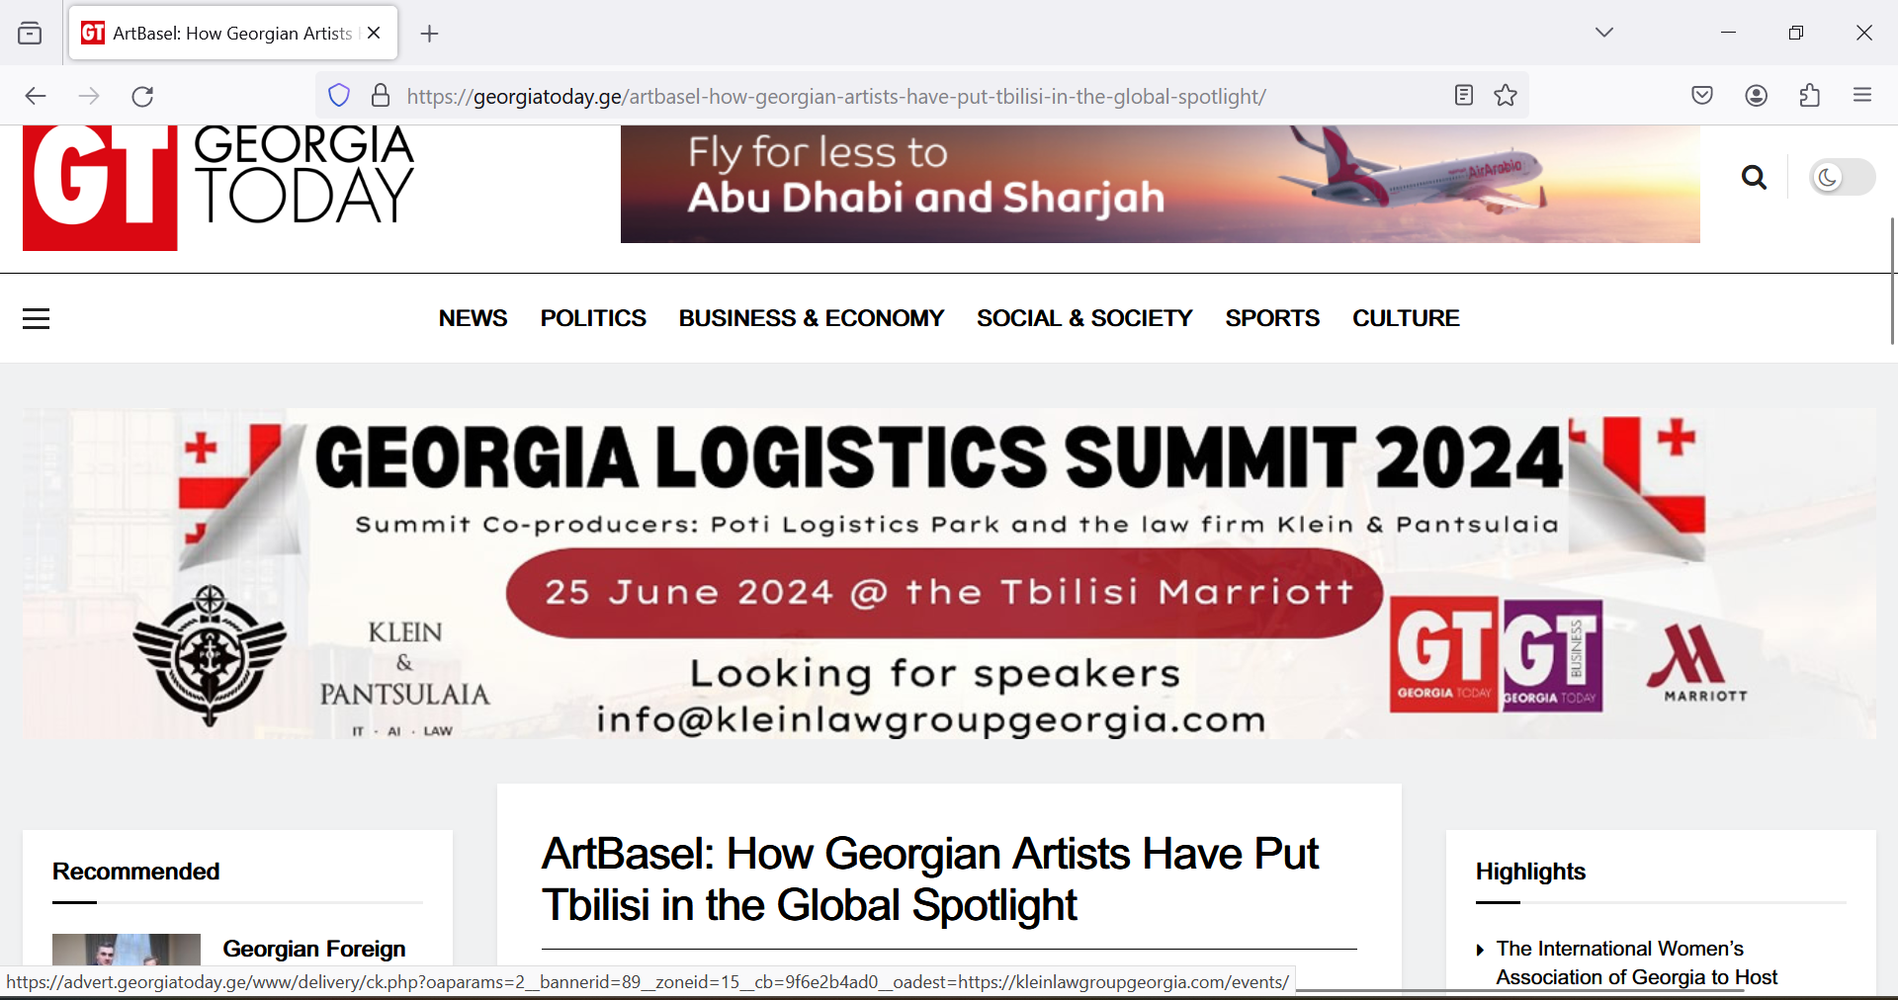
Current Banner on www.georgiatoday.ge
Banner appears on front page and alls pages
Banner viewed every 11 Seconds

Slide 6
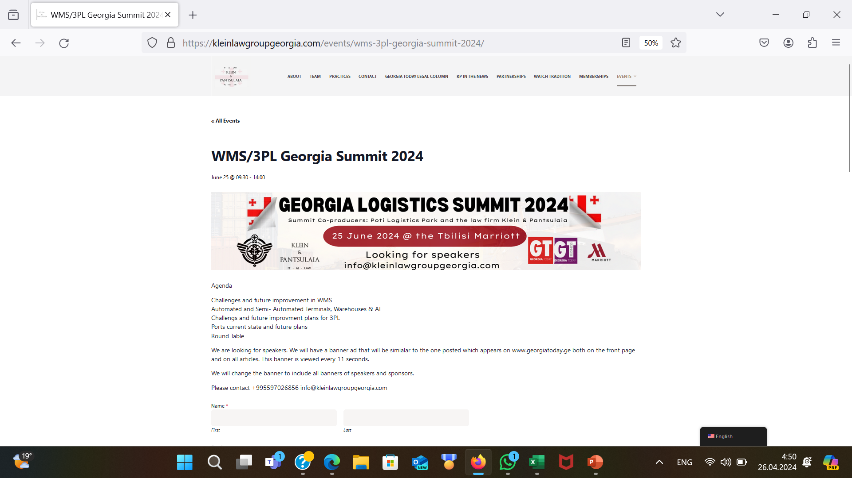
Delegate Registration Page

Slide 7
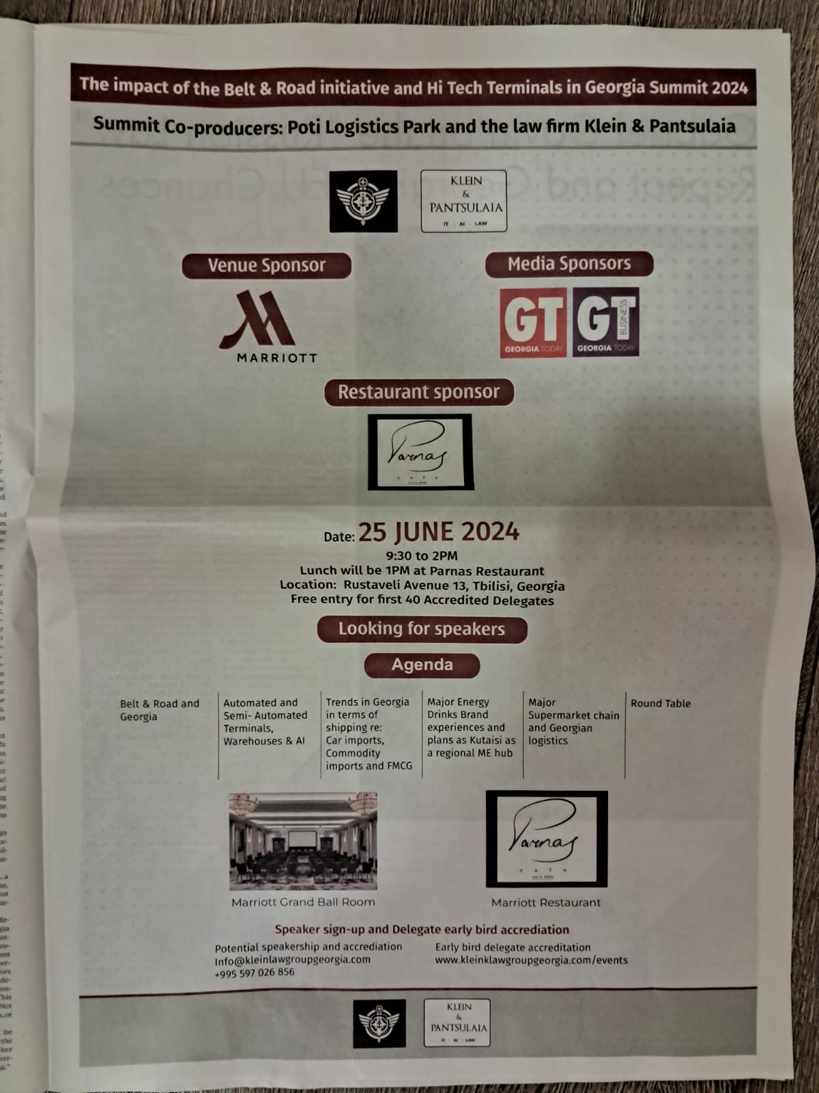
GT FULL PAGE
AD 5 April 2024
Notes:
The impact of the Belt & Road Initiative and Hi Tech Terminals in Georgia 2024 Summit

Slide 8
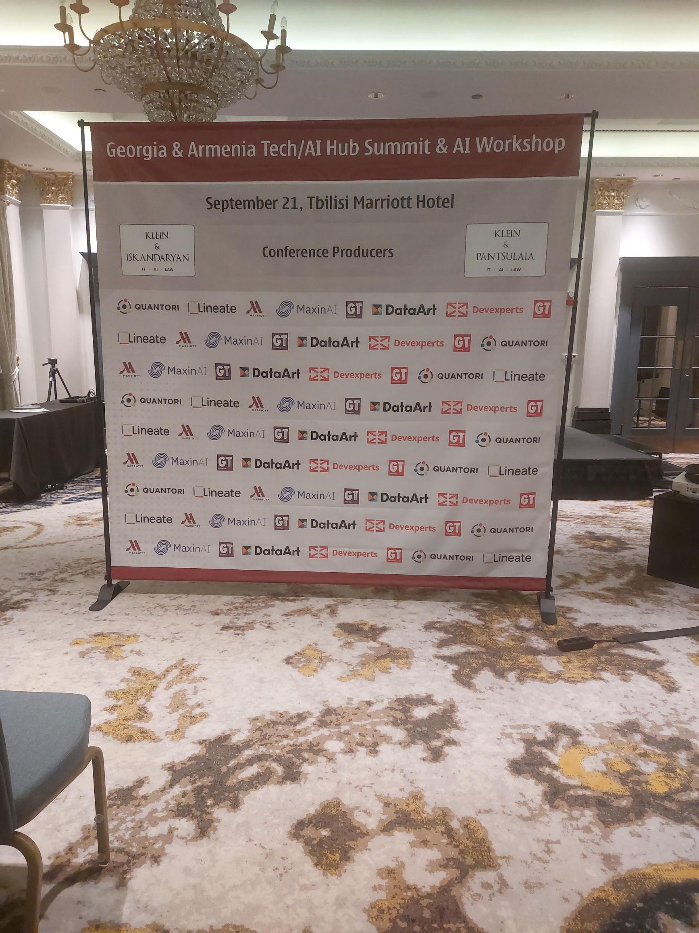



Sample Press wall (prior event in 2023) all speaker’s logos
Prior events were sponsored
By the likes of (this was an IT event of course we are looking for
Major players in Logistics)

Slide 9
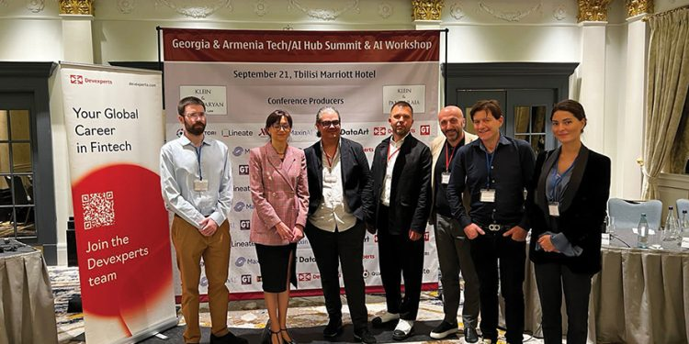
GT Post Summitt
Article an example from prior Summits
On September 21, the Tbilisi Marriott hosted the highly anticipated Georgia & Armenia Tech/AI Hub Summit 2023, a collaborative effort between Georgia-Based law firm Klein & Pantsulaia and Armenia-based law firm Klein & Iskandaryan. The Tech conference was sponsored again by GEORGIA TODAY, GT Business and Tbilisi Marriott. Speakers included Lineate, Devexperts (in the Fintech space), Quantori (in Healthcare IT) and MaxinAI. An AI workshop was also held by Professor Jose Romero, who is a Mexican Intellectual Property residing in Georgia. DataArt was also present as a special guest delegate.
The Summit was honored to have as a panelist Giorgi Tsikolia, Lineate´s Regional Director and formerly Deputy Chief of Mission (COO) Embassy of Georgia to the US.
he panelists spoke about the challenges of doing business in Georgia and Armenia. One issue that some subsidiaries of foreign IT companies faced was the new due diligence on bank accounts by their banks, carried out even if their accounts were a year or more old. Apparently, some of these companies had had their bank accounts frozen in the process.
The consensus of the speakers was that AI will not impact staff numbers at least for the time being. MaxinAI is a local Georgian AI consultancy which assists companies in Georgia and other countries to use Artificial Intelligence to improve systems, and processes. For example, it helps factories to become more efficient and reduce waste. Another greening example is using AI to improve power plant efficiencies, resulting in cost savings and reduced greenhouse gas emissions.
There were heated discussions about software coders and their tendency to use the likes of ChatGPT (owned by Microsoft) to create or aid in coding. Several issues were discussed about the legality of such a use and also if the company where said IT engineer works would own the resulting software. The idea was floated suggesting that companies should probably review code created by staff to ensure that AI had not been utilized, as, if the percentage of code created by deveopers is in majority done using ChatGPT, they may well find that the real owner of the resulting software is Microsoft.
Klein & Pantsulaia also announced that they are setting up a new AI business consultancy based upon a joint venture with a local Georgian AI consultancy, whichl has dozens of AI consultants.
The next event will be similar to past events, but with a bigger focus on artificial intelligence. The Georgia & Armenia Tech/AI Summer Summit will be held at the Marriott Armenia in Yerevan in mid-November. The date may be adjusted in accordance with the political situation in Armenia as it develops. There will also be an interactive AI training workshop. Devexperts and Oracle are already confirmed as speakers for the event, and IT companies will also be invited.
LINK GT Sponsors Georgia & Armenia Tech/AI Hub Summit 2023 in Georgia - Klein Law Group Georgia

Slide 10
Daniel Klein +597026856, Klein@KleinLawGroupGEORGIA.com
Georgia Klein & Pantsulaia www.kleinlawgroupgeorgia.com
Armenia Klein & Iskandaryan www.kleinlawgrouparmenia.com
Russia Vasiliev Klein, Usov & Litvinov (pls note we do not associate with VKUL nor mention it anywhere on our sites or in ad materials for events) www.vkupartners.com

